Slide 1
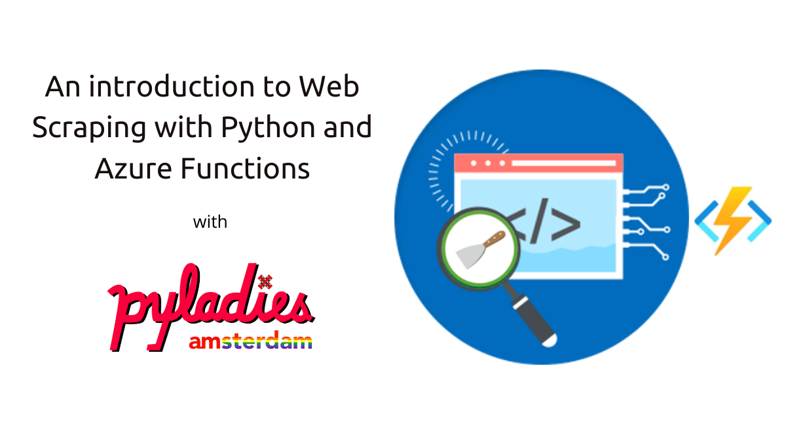
Welcome!
26-05-2021

Slide 2



Hello!
I am Daniela Miranda
and I’m here because I’m passionate about Data

Slide 3
Agenda
1- Web Scraping (generating output)
2- Blob Storage (storing the output)
3- Wordcloud (convert output into a wordcloud)

Slide 4
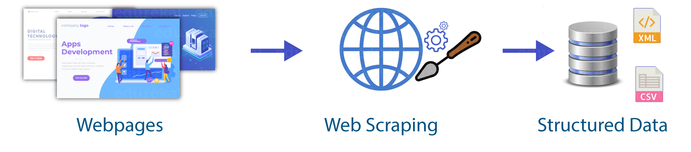
Web Scraping
Common uses
Benefits
How to scrape data from a website?
Scrapy
Where to store the output?
Notes:
Web scraping is an automated method used to extract large amounts of data from websites. The data on the websites are unstructured. Web scraping helps collect these unstructured data and store it in a structured form. There are different ways to scrape websites such as online Services, APIs or writing your own code. In the first section of this workshop, we’ll see how to implement web scraping with python.

Slide 5



Common uses
Price comparison
Email address gathering
Research and development
Is web scraping legal ? A guide for 2021: https://www.linkedin.com/pulse/web-scraping-legal-guide-2021-tony-paul/?trk=read_related_article-card_title
Notes:
Price Comparison: Services such as ParseHub use web scraping to collect data from online shopping websites and use it to compare the prices of products.
Email address gathering: Many companies that use email as a medium for marketing, use web scraping to collect email ID and then send bulk emails.
Research and Development: Web scraping is used to collect a large set of data (Statistics, General Information, Temperature, etc.) from websites, which are analyzed and used to carry out Surveys or for R&D.

Slide 6
Benefits
From the business point of view:
To achieve automation
Acquisition of insights
Unique and rich datasets
From python point of view:
Easy to use
Community support
Several options for web scraping
Notes:
Achieve Automation
Robust web scrapers allow you to automatically extract data from websites, this allows you or your co-workers to save time that would’ve have otherwise been spent on mundane data collection tasks. It also means that you can collect data at greater volume than a single human could ever hope to achieve.
Business Intelligence & Insights
Web scraping data from the internet allows you to search for competitor prices, monitor their marketing activity and to swiftly market research your industry online. By downloading, cleaning and analysing data at significant volume, you’ll be able to build a better picture of your market, your competitor’s activity which in turn will lead to better business decision making.
Unique and rich datasets
The internet provides you with a rich amount of text, image, video and numerical data and currently contains at least 6.05 billion pages. Depending upon what your objective is, you can find relevant websites, setup website crawlers and then make your own custom dataset for analysis.

Slide 7
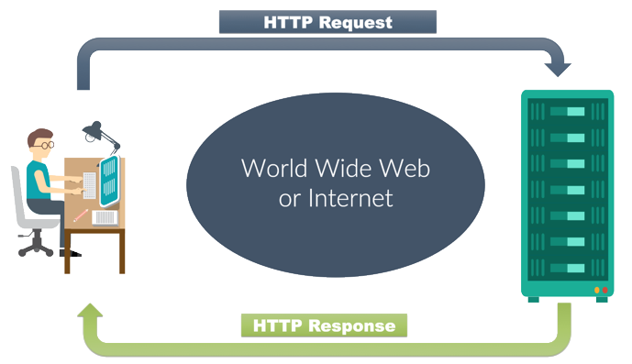
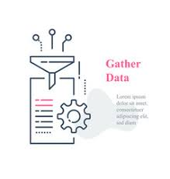

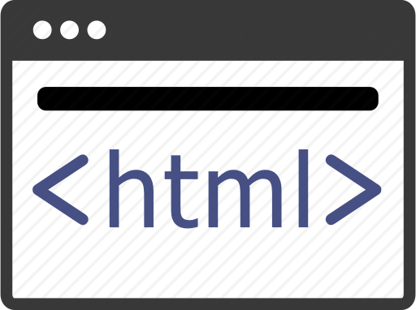
How to scrape data from a website?
Food recipes
Code
Notes:
When you run the code for web scraping, a request is sent to the URL that you have mentioned. As a response to the request, the server sends the data and allows you to read the HTML or XML page. The code then, parses the HTML or XML page, finds the data and extracts it.
What is HTTP: Hyper transfer protocol, web application layer protocol using client/servermodel

Slide 8
How to scrape data from a website?
Find the URL that you want to scrape
Inspecting the Page
Find the data you want to extract
Write the code
Run the code and extract the data
Store the data in the required format
Food recipes
How to do it automatically and in a robust way?
Notes:
Click on the page and show the inspection process and how the page look in the backend
Once back on the presentation, share that to automate steps 3-6 Scrapy was created. That is the intro to next slide

Slide 9

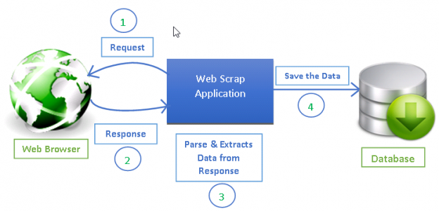
Scrapy
A framework for extracting, processing, and storing web data
Initial release in June 2008

Slide 10




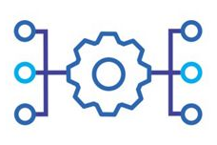
Scrapy
Main components:
Spiders
Items
Pipelines
Settings
Middlewares
Notes:
Spiders: self-contained crawlers that are given a set of instructions
Items: Spiders return the extracted data as items, Python objects that define key-value pairs
Pipelines: They process the items through several components that are executed sequentially. After an item has been scraped by a spider, it is sent to the pipeline
Typical uses of item pipelines are:
cleansing HTML data
validating scraped data (checking that the items contain certain fields)
checking for duplicates (and dropping them)
storing the scraped item in a database
Settings: The Scrapy settings allows you to customize the behaviour of all Scrapy components, including pipelines and spiders themselves
Middlewares: Spider and downloader. Spider Middleware is a framework of hooks into Scrapy’s spider processing mechanism where you can plug custom functionality to process the responses that are sent to Spiders for processing and to process the requests and items that are generated from spiders. Downloader middleware is a framework of hooks into Scrapy’s request/response processing. It’s a light, low-level system for globally altering Scrapy’s requests and responses.

Slide 11
Scrapy – Hands on
Pre-requisites:
Python installed (Check requirements.txt in GitHub repository)
Code Editor of preference. Recommended for today: VSCode
Outline:
Page to scrape: Food recipes
Goal: Get the list of dish names of British cuisine

Slide 12

Demo Time (1)
Task:
Pick 5 cuisines of your preference and crawl the recipe names from all of them

Slide 13
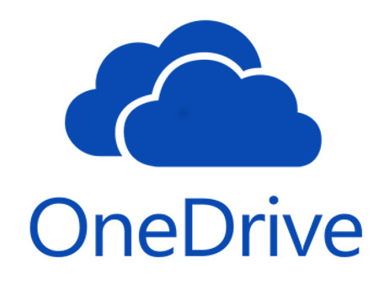



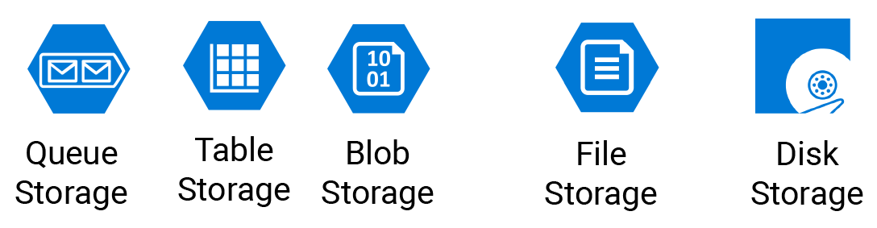
Storing
Text file on local machine
Store it on a Database
What if you are a DS and work on a team. You want your other teammates to see your scraped data. How?
Notes:
Save outcome of scrapy downloading on local machine
One drive -> not everyone has access to it, you have to manage access
If company works in the cloud, high probability of Azure Storage, the cheapest way to store info
Intro to blob, one type of Azure storage

Slide 14

What is a Blob storage?
Blob storage is optimized for storing massive amounts of unstructured data. Unstructured data is data that doesn't adhere to a particular data model or definition, such as text or binary data.
Notes:
Blob storage is designed for:
Serving images or documents directly to a browser.
Storing files for distributed access.
Streaming video and audio.
Writing to log files.
Storing data for backup and restore, disaster recovery, and archiving.
Storing data for analysis by an on-premises or Azure-hosted service.

Slide 15
Blob Storage creation – Hands on
Pre-requisites:
Create your azure account here
Create a storage account
Create blob container
Outline:
Create input and output folders
Upload our text file to input folder

Slide 16
Demo Time (2)
Task:
Create your storage account and input/output folders via CLI

Slide 17
Wordcloud: Azure Functions
What is a Wordcloud?
How to generate a Wordcloud using Azure Functions?

Slide 18
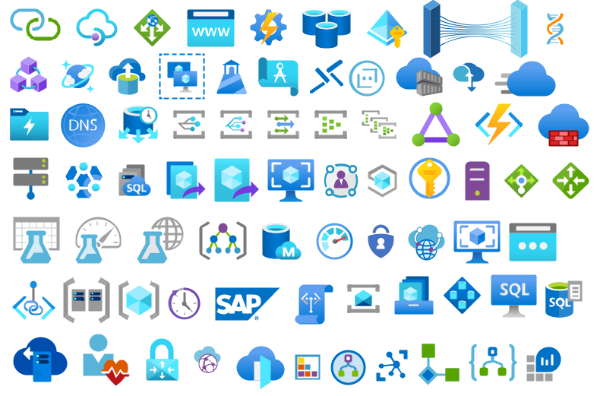
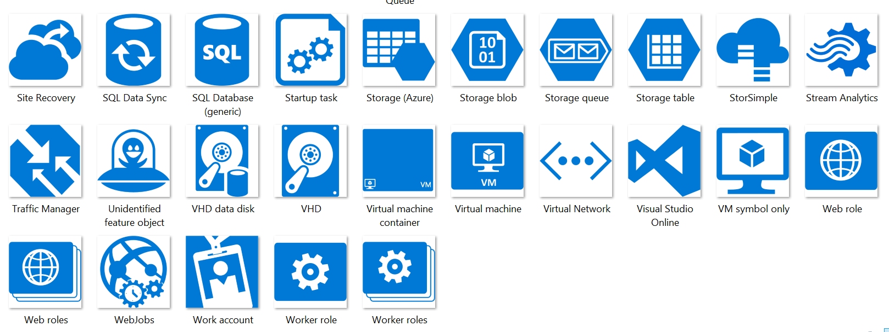
Microsoft Azure
Notes:
Microsoft Azure, commonly referred to as Azure, is a cloud computing service created by Microsoft for building, testing, deploying, and managing applications and services through Microsoft-managed data centers. It provides software as a service (SaaS), platform as a service (PaaS) and infrastructure as a service (IaaS) and supports many different programming languages, tools, and frameworks, including both Microsoft-specific and third-party software and systems.

Slide 19

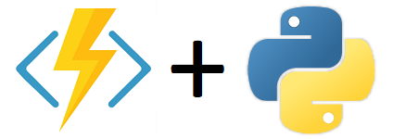
Azure functions
serverless, lightweight, language independent
“Azure functions allows you to implement you systems logic into readily available blocks of code, these code blocks are called functions.”
Azure functions in depth: https://github.com/pyladiesams/Azure-functions-beginner-mar2020

Slide 20
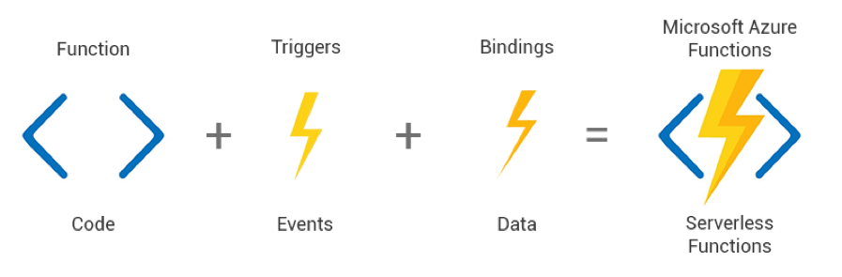
2 additional components of the function: Triggers and Bindings
Triggers: determines the way the function will execute
Bindings: determines the input and output of my function

Slide 21
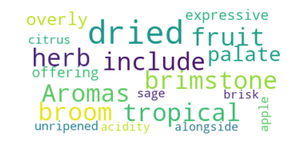

Blob storage trigger
Text file input

Slide 22
What is a Wordcloud?
Collection of clusters of words
WordCloud is a technique to visualize which words are the most frequent among the given text.

Slide 23
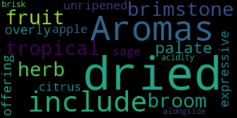


How to generate a Wordcloud?
Extract the text from file in input folder
Create and generate a wordcloud image:
Split the text in tokens
Remove repetitive words
Count word frequency
The words with higher frequency will be shown in a bigger size
Save the image in output folder

Slide 24
Wordcloud using Azure Functions– Hands on
Pre-requisites:
VSCode
Azure Functions Core Tools
Python Extension for VSCode
Azure Functions Extension for VSCode
Outline:
Create local project
Create code for wordcloud generation
Run the function locally
Publish the project to Azure
Run the function in Azure

Slide 25

Demo Time (3)
Tasks:
Make sure your function is triggered by only txt files
Change the color and shape of your wordclouds

Slide 26
Useful resources
Scrapy documentation: https://scrapy.org/
Azure documentation: https://docs.microsoft.com/en-gb/learn/modules/fundamental-azure-concepts/
Azure functions for beginner – Pyladies: https://github.com/pyladiesams/Azure-functions-beginner-mar2020
Azure function – Microsoft documentation: https://docs.microsoft.com/en-us/azure/azure-functions/create-first-function-vs-code-python
Wordcloud tutorial: https://www.datacamp.com/community/tutorials/wordcloud-python

Slide 27

Questions?

Slide 28
Daniela Miranda
@danielamiranda
@ElaMirandar
LinkedIn Daniela
@pbblnl
@pebbledotnet
Website Pebble

